Slide 1
Importance of Multidisciplinary Training in Healthcare
Dr. Kithsiri Edirisinghe, MD

Slide 2
Content
Patient care services, team work and THE PRECISION
Current gaps in patient care services and THE INTERFACE
The need for a Multi -disciplinary Training Approach and SMART TEAMS

Slide 3
A. Patient care services and team work

Slide 4
The Precision of Team work
Speed of a formula I car is 200 KMPH
Process of supporting this high risk activity
Ferrari F1 Pit Stop Perfection Slow Motion.avi

Slide 5
Precision of Healthcare Teamwork
How Emergency Rooms Work DOCS CHANNEL cut.mp4
Who are the team players ?
Who is leading the team?
What does precision has to do with it ?
What else is needed ?

Slide 6
The healthcare services
“Defeating death” - how hopeful it seems…..!
Developing skills in the “battle field “
The interface
Human , equipment, Drugs
The plan >>> methods
The Precision >> quality >> healthcare risk management
THE INTERFACE & THE PRECISION

Slide 7
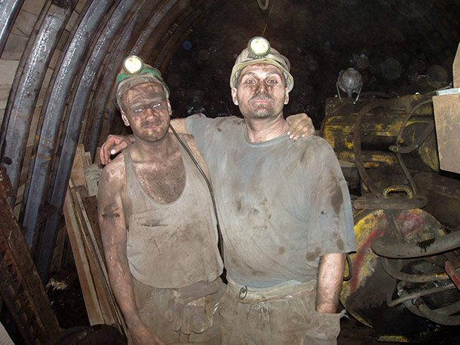
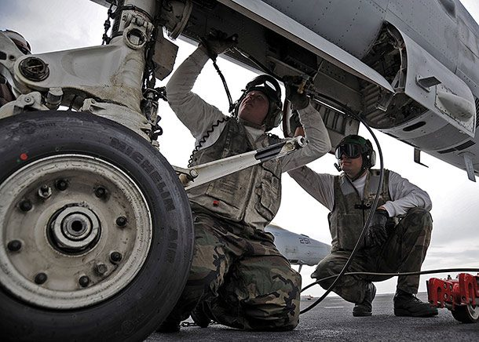
The “production line”
Airline industry
Mining industry
Healthcare services ?
The patient load ? Sri Lankan 600 hospitals >> 60 Mn OPD visits and 6 Mn IPD patients annually
“Healthcare service process is the most dynamic, risky , unpredictable , costly and complex “ production line” in the world….!
“There are always grey areas which attributes to unpredictability & the risk
Time has come to look at the “ Moment of Truth”… the precision of the Intervention”

Slide 8
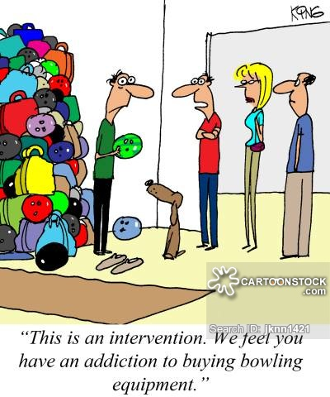
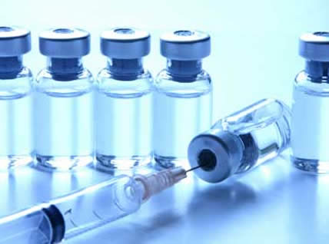
The Intervention into body systems

Slide 9
The healthcare service as a process
Input
“Unwell Consumer”
Process
“Intervention”
Output
“Well managed Consumer”

Slide 10
The INTERFACE
Human Interface
Healthcare worker and the patient
Healthcare team
Human and other interfaces
Equipment
Supplies ( Drugs)
Space ( Building )

Slide 11
Controlling THE INTERFACE
The plan – to achieve PRECISION
The controls
Clinical Standards
Organizational Standards
Ethical standards
Legal standards
Professional standards

Slide 12
The Healthcare Team Profile
Clinical
Medical Doctors
Nurses
Physiotherapist / Occupational Therapist
Diagnostic –Laboratory, Radiology , Cardiology , Neurology ..etc.
Ancillary – Blood bank , CSSD, ….etc.
Non clinical – Administrators, Facility managers, Financial managers, Social workers
They all will have to “work as a team” to give precision / quality healthcare services

Slide 13
Effective Clinical Teams
A team refers to two or more individuals, each with specific roles, working toward a common goal with concrete boundaries.
Teams work on complex tasks requiring a dynamic exchange of resources (e.g. information), coordination of effort, and adaptation to changing situational factors.
Teamwork is the vehicle through which such coordination occurs.
It is defined in terms of :
Cognitions (e.g. shared mental models)- Knowledge
Behaviors (e.g. closed-loop communication)- the skill
Attitudes (e.g. collective efficacy, trust)
that combine to make adaptive interdependent performance possible.
KSAs

Slide 14
The Ideal Team … the SMART team
Ideally Inter-professional team has to work as a Professional unit developed as per patients needs
Ideal scenario: the team members will have a mutual respect for each other and an equal value placed on their contribution to clinical practice
Currently innovative methods have been used in Acutely ill patients & in Palliative care

Slide 15
B. Gaps in Patient Care Services and the issues with the Interfaces

Slide 16
Eight Common Root Causes for Medical Mishaps in the Clinical Setting
Communication Problems
Inadequate Information Flow
Human Problems
Patient-Related Issues
Organizational Transfer of Knowledge
Staffing Patterns and Workflow
Technical Failures
Inadequate Policies
Source : Healthcare Research and Quality,2017

Slide 17
Common barriers for Team work in healthcare
The Barriers
Different ideologies & different goals
Unequal power and advantage for some
Role overlap & confusion
Communication

Slide 18
1. Different ideologies & different goals
Fundamental ideologies in different professions
Care
Cure
Confusion scope , objective & goals
Example – Discharging a Diabetic patients recovered from coma without proper dietary advise
Source : Different ideologies & different goals (Stevenson1985, Beatle 1995 )

Slide 19
2. Unequal power and who has the advantage ?
Unequal power relations exits among healthcare professionals
Balance of power located with more older , more established medical professionals and minimal with other professionals such as Nursing, Allied health sciences, Social sciences.
Example – contribution to decision making in Ward rounds
Source : Unequal power and who has the advantage ?(Blane & Hugeman,1991, Carrier & Kendall, 1995 )

Slide 20
3. Barriers to Communication
Communication practice
Intra professional
Inter professional
Direct impact in patient care
Methods
Face to face
Telephone
Dialogue through documentation ( the vital root)
Case notes
Clarity , meaning & the standards of the Language used
Source : Barriers to Communication dialogue (Kilcoyne1991 )

Slide 21
4. Role overlap & Confusion
Lack of clarity in :
Professional roles
Functional roles
Responsibility
Accountability
Lead to Breakdown in communication
Example : wheelchair prescribed by Physiotherapist for a patient with disability and occupational therapist opposing the view
Source : The NHS plan (DOH , UK, 2000 )

Slide 22
C. The Need for a Multi -Disciplinary Training Approach

Slide 23
The healthcare team work & training

Slide 24
The Current Training –Training
Filling the GAP between >>>>>> Trainees learner profile and the Job description of the healthcare professional
Training will give competence to make the professional in the same field to fulfill the scope of work or the Job description of the Nurse / Doctor / Physiotherapist >>> making them competent in their profession
Contribute to the development of Unique Values, Cultures , Work Ethics
There is minimal attention to multi-disciplinary training specially in Sri Lanka
Collaborative training
Training on Multi-disciplinary practice

Slide 25
D. “Building SMART Teams in the Clinical Setting”

Slide 26
The strategy – collaborative effort
Evidence based approach
Research
Research in the area – process , structure , contribution
Process analysis & KSA ( key result areas)
Scope definitions and Job descriptions
Training Need Analysis
The problem location – developmental issues of each professional and the history
Professional surveys
Patient survey
Case based studies & reflection
Policies
Clinical /professional / organizational / legal & ethical
Policies that seek to achieve flexible inter-professional practice that are not constrained by professional boundaries.
Contributors
Health administrators
Professional colleges
Professional bodies
Trade unions
Patient groups

Slide 27
The strategy – collaborative effort
Implementation
Education on the policies & guideline
Creating and conducive culture
Creating organizational culture that is conducive to improve goodwill among the staff and goodness to patients
Inter-professional workshops in the latter stages of Basic training would support in facilitating working and good relationship across the professional career
Promoting shared philosophy of a team by shared education and training
Moving from Uni- disciplinary post registration training to collaborative training , education , TNA

Slide 28
The strategy – collaborative effort
Monitoring
Continuous process as a part of their JD
Professional team – case boards / departmental meetings / ward rounds
Administrators
Quality officers
Evaluation
Reviews
Case studies
Reflections
Inter- professional team Research
Continuous improvement

Slide 29
Benefits of a SMART Team ..
Improved patient outcomes
Reduced length of stay
Cost saving
Increased job satisfaction
Improved teamwork

Slide 30
Thank you! drkithsiri@iihsciences.edu.lk
References
Caldwell, K. and Atwal, A. (2003). The problems of interprofessional healthcare practice in hospitals. British Journal of Nursing, 12(20), pp.1212-1218.
Weaver, S., Lyons, R., DiazGranados, D., Rosen, M., Salas, E., Oglesby, J., Augenstein, J., Birnbach, D., Robinson, D. and King, H. (2018). The Anatomy of Health Care Team Training and the State of Practice: A Critical Review.
AgileConnection. (2018). 7 Keys to Building Great Work Teams. [online] Available at: https://www.agileconnection.com/article/7-keys-building-great-work-teams

